Slide 1



Slide 2
Filters
A filter is a circuit that passes certain frequencies and attenuates or rejects all other frequencies.
The passband of a filter is the range of frequencies that are allowed to pass through the filter with minimum attenuation (usually defined as less than -3dB of attenuation).
The critical frequency, (also called the cutoff frequency) defines the end of the passband and is normally specified at the point where the response drops -3dB (70.7%) from the passband response.

Slide 3
Filter types
Low pass filter (LPF)
High pass filter (HPF)
Band pass filter (BPF)
Band stop filter (BSF)

Slide 4
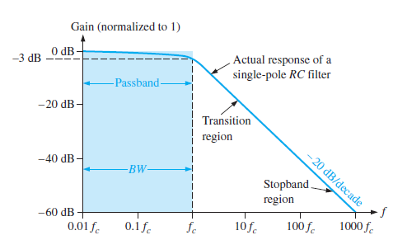
Ideal LPF Filter Response

Slide 5
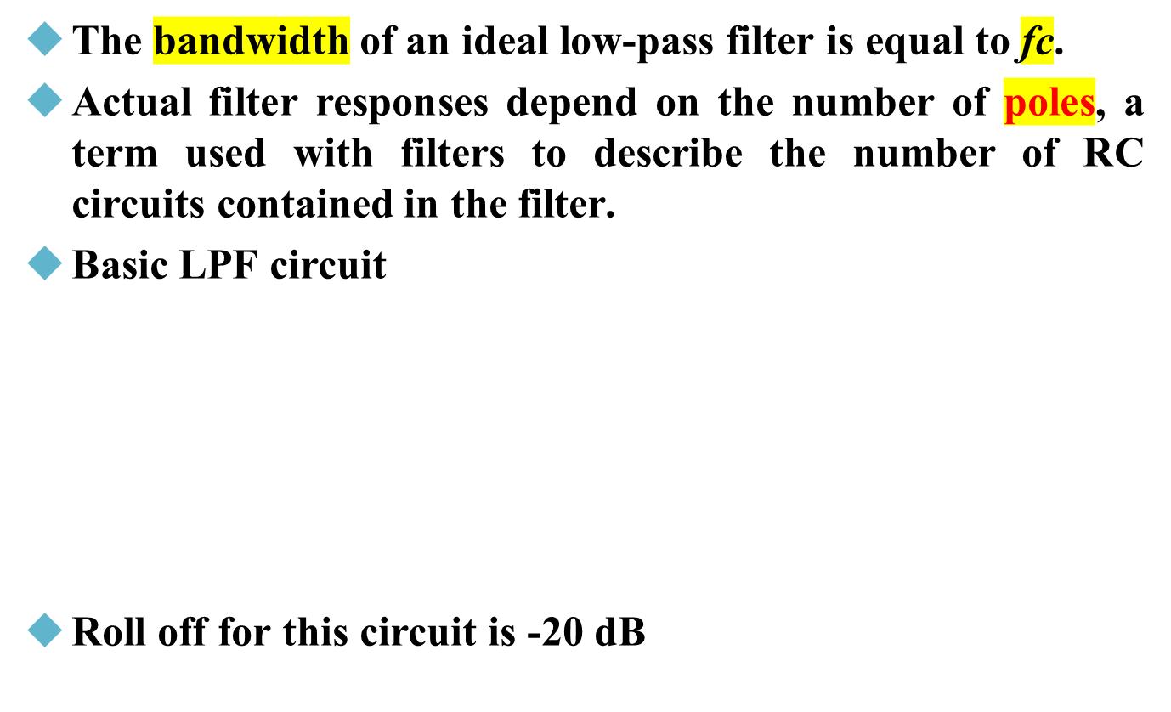
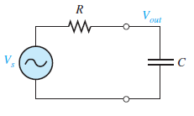

LPF

Slide 6
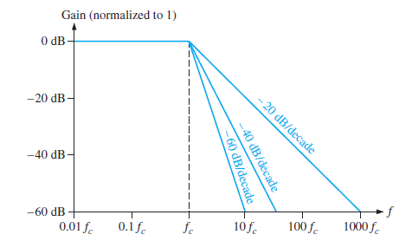
LPF
The -20 dB roll-off rate for the gain of a basic RC filter means that at a frequency of 10 fc, the output will be (10%) of the input.
This roll-off rate is not a particularly good filter characteristic because too much of the unwanted frequencies (beyond the passband) are allowed through the filter.

Slide 7
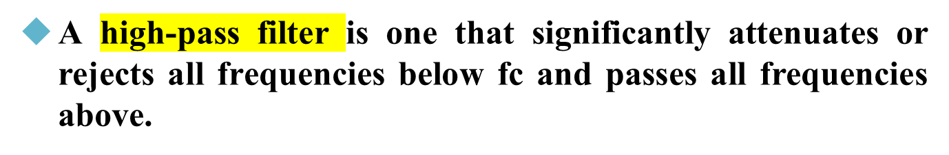
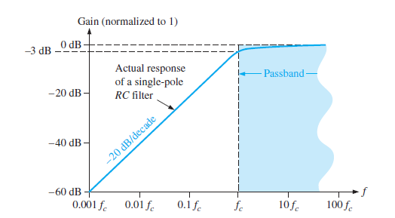
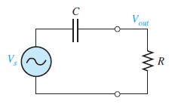
High Pass filter

Slide 8
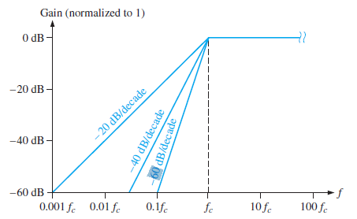
HPF

Slide 9
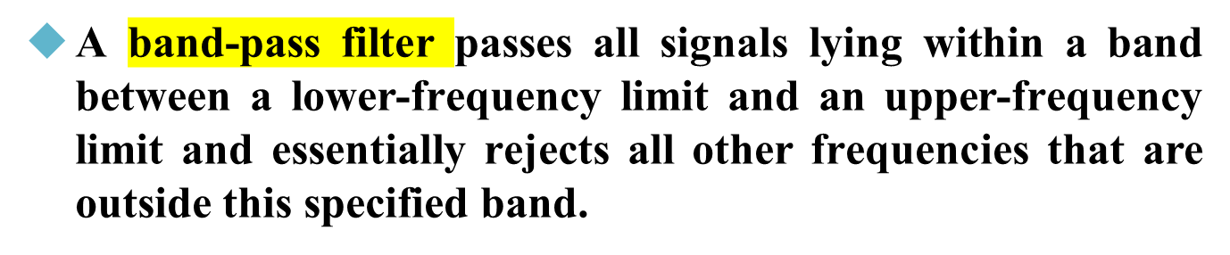
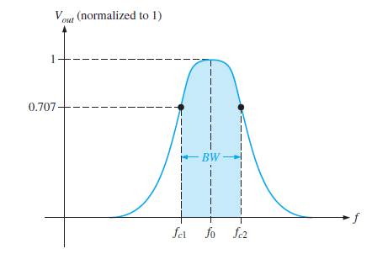

Band-Pass Filter

Slide 10
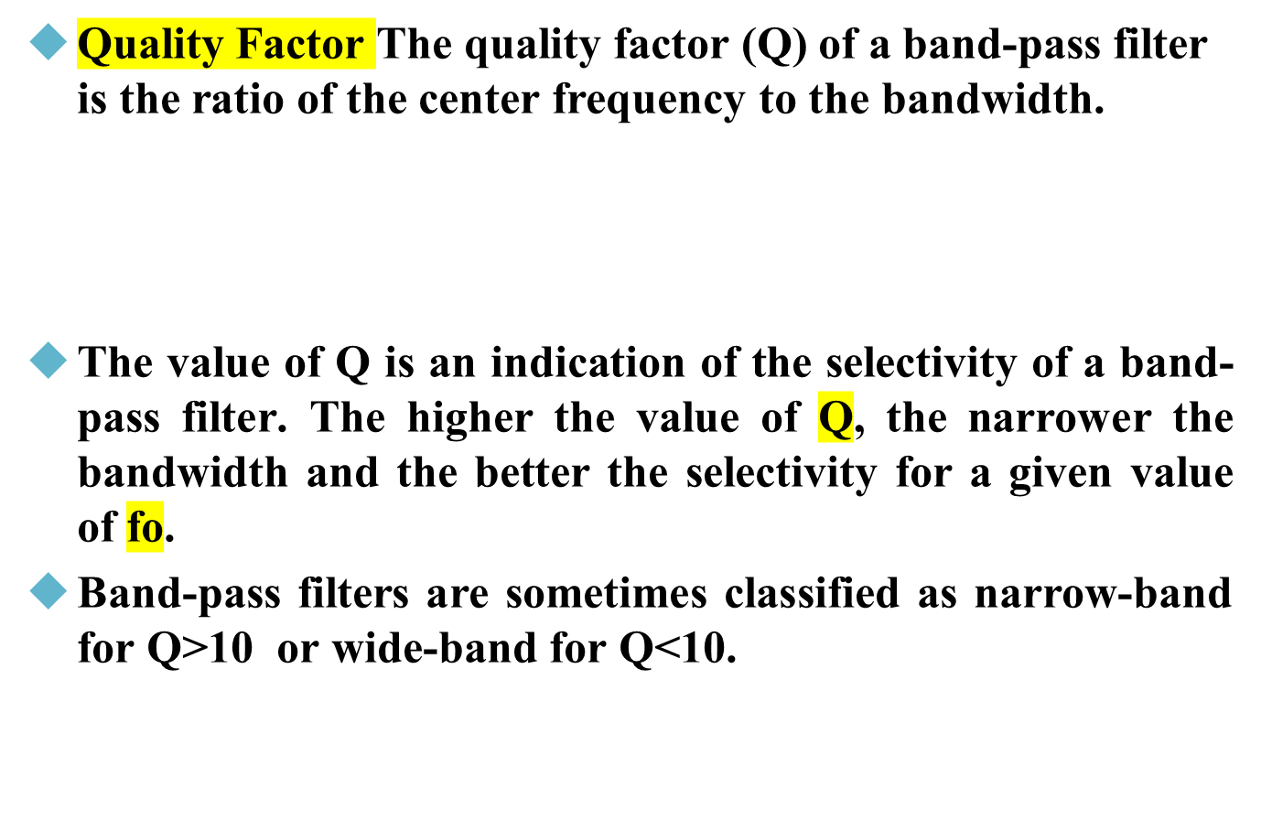

BPF

Slide 11
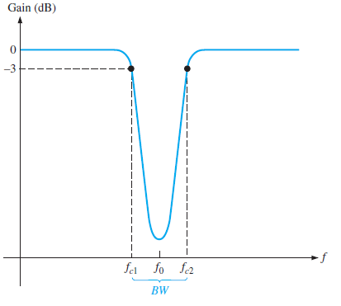
Band-Stop Filter
Also known as notch, band-reject, or band-elimination filter.

Slide 12
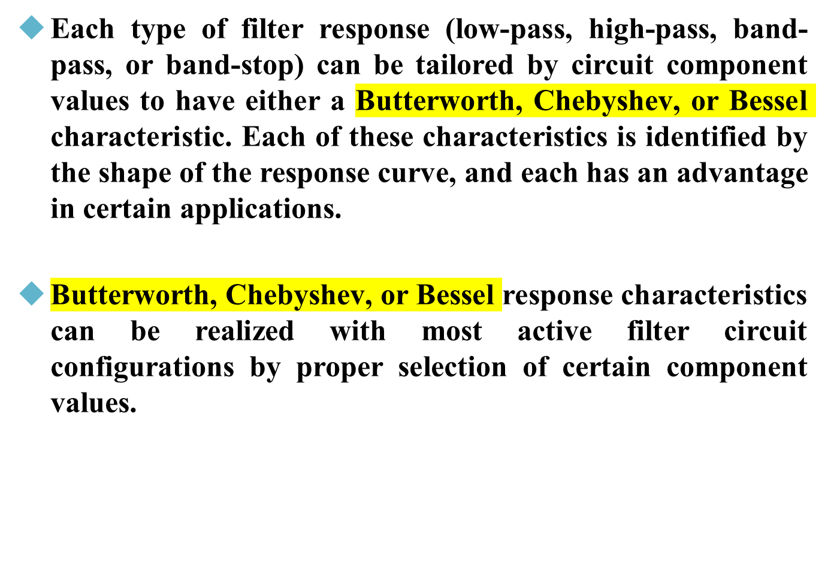
Filters Response

Slide 13
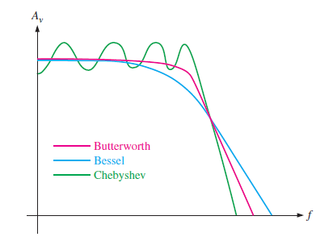
Filters Response
A general comparison of the three response characteristics for a low-pass filter response curve is shown in Figure below
High-pass and band-pass filters can also be designed to have any one of the characteristics.

Slide 14
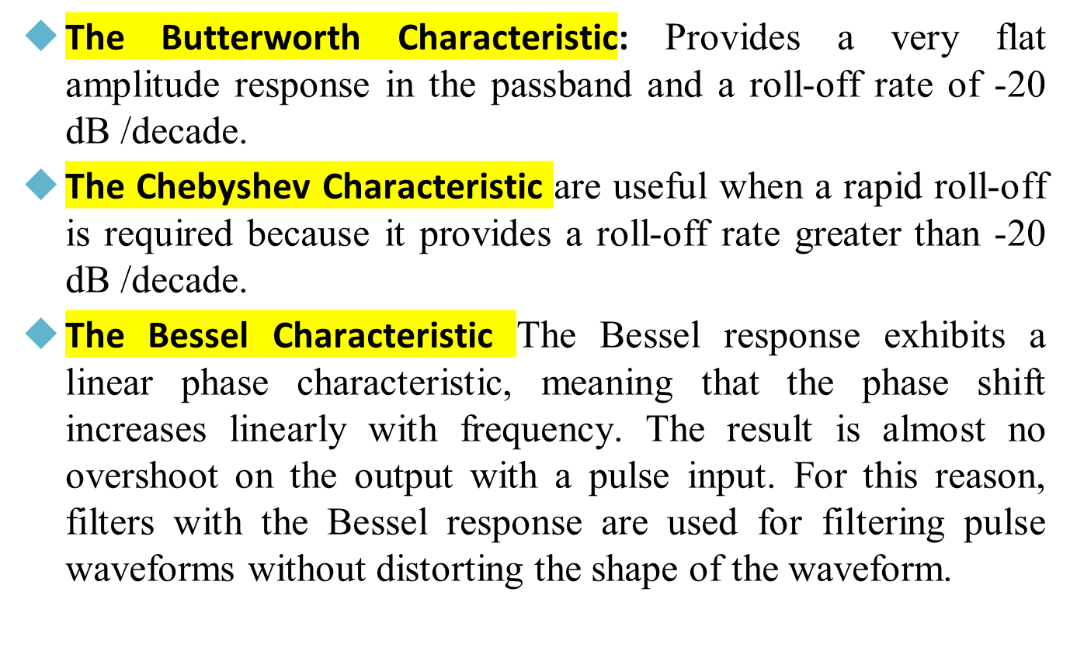
The Butterworth Characteristic

Slide 15
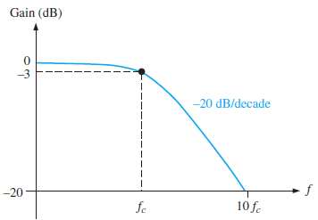
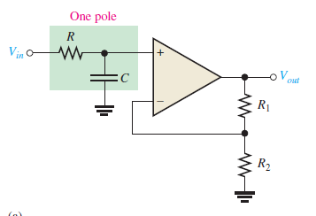

Active Low Pass filter

Slide 16
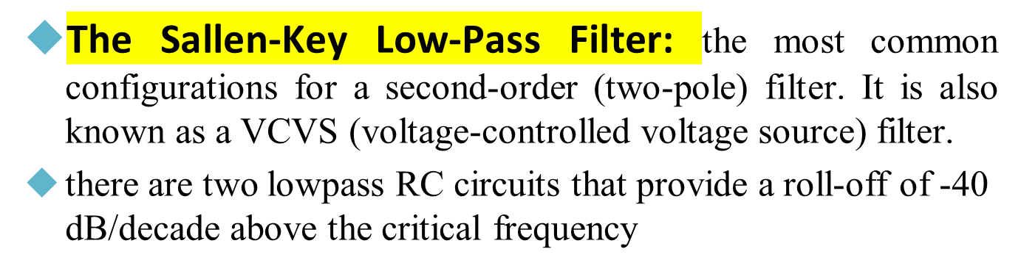
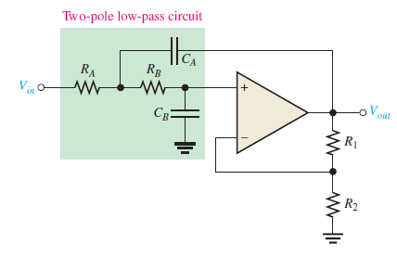

Active Low Pass filter

Slide 17
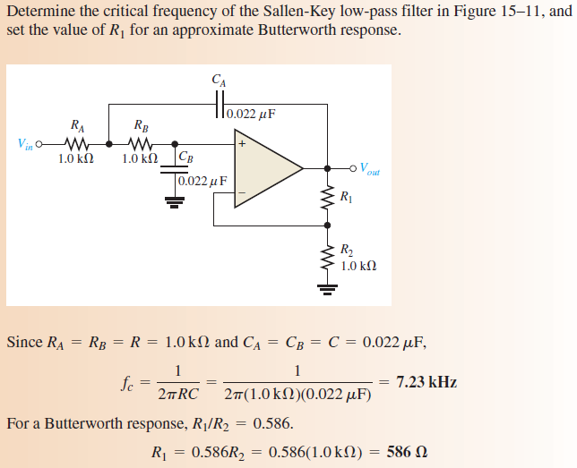
Active Low Pass filter

Slide 18
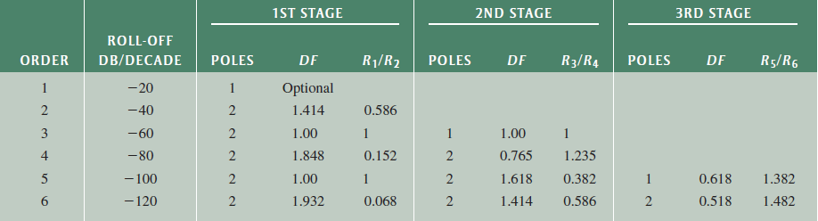
Active Low Pass filter

Slide 19
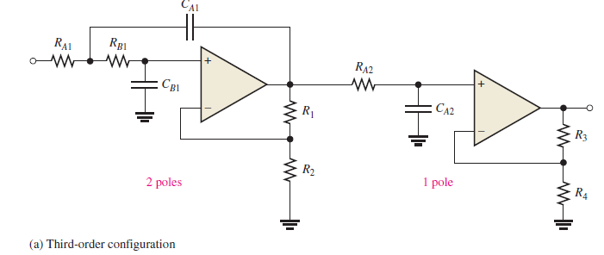
Cascaded Low-Pass Filter

Slide 20
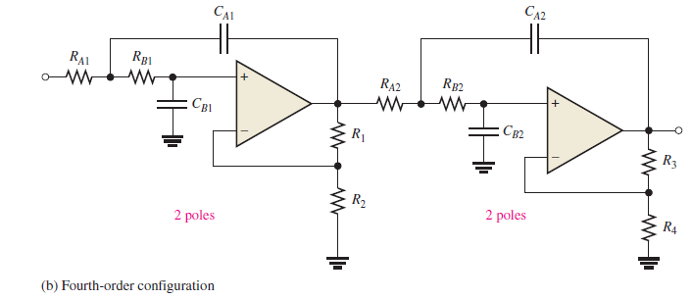
Cascaded Low-Pass Filter

Slide 21
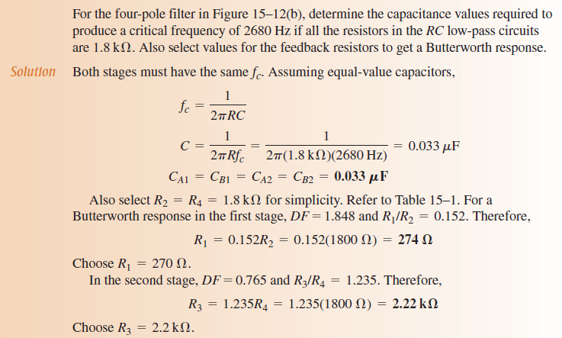
Cascaded Low-Pass Filter

Slide 22
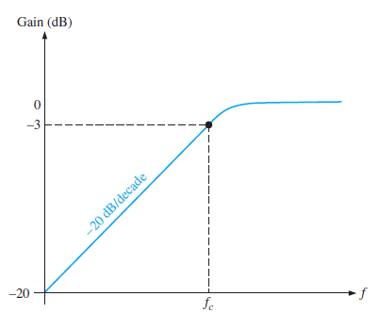
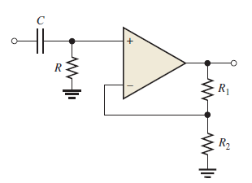
Active High Pass filter

Slide 23
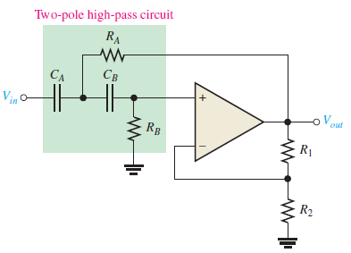
The Sallen-Key Low-Pass Filter

Slide 24
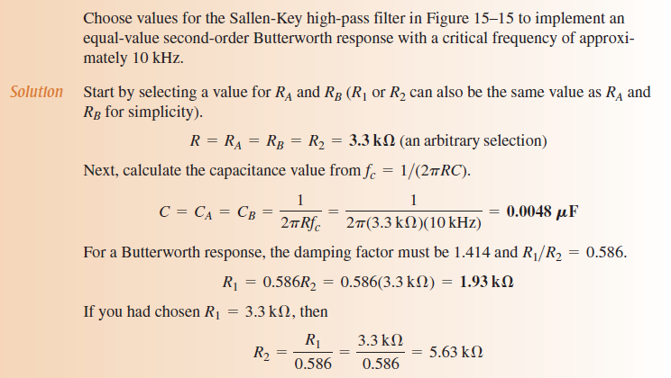
The Sallen-Key Low-Pass Filter

Slide 25
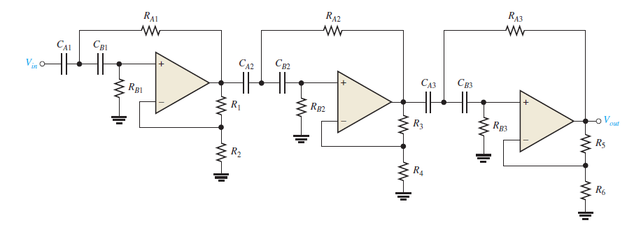
Cascaded high-Pass Filter
As with the low-pass configuration, first- and second-order high-pass filters can be cascaded to provide three or more poles and thereby create faster roll-off rates.

Slide 26


ACTIVE BAND-PASS FILTERS
One way to implement a band-pass filter is a cascaded arrangement of a high-pass filter and a low-pass filter.
The critical frequency of the high-pass filter must be sufficiently lower than that of the low-pass stage.
This filter is generally limited to wide bandwidth applications.
The lower frequency of the passband fc1 is the critical frequency of the high-pass filter.
The upper frequency is the critical frequency of the low-pass filter fc2.

Slide 27
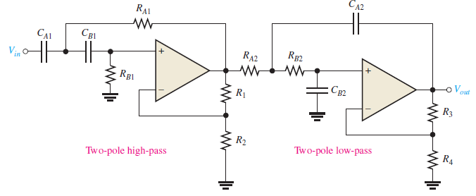
ACTIVE BAND-PASS FILTERS

Slide 28
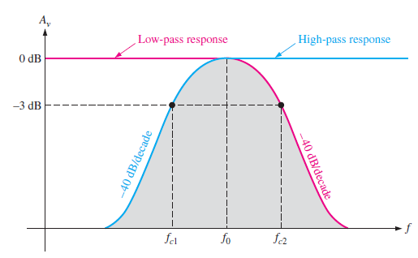
ACTIVE BAND-PASS FILTERS

Slide 29

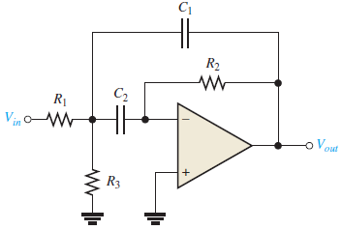

Multiple-Feedback Band-Pass Filter
Two pole filter
Components R1 and C1 provide the low-pass response, and R2 and C2 provide the high-pass response.
The maximum gain, A0, occurs at the center frequency fo.
Q values of less than 10 are typical in this type of filter.
If C1 = C2 = C then

Slide 30


Multiple-Feedback Band-Pass Filter

Slide 31
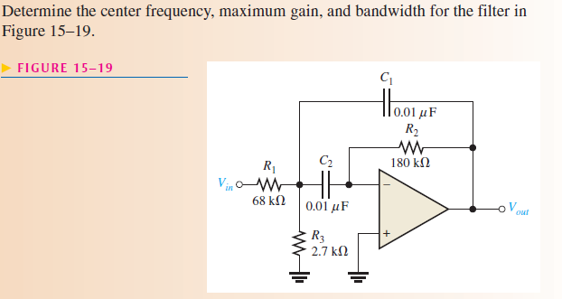
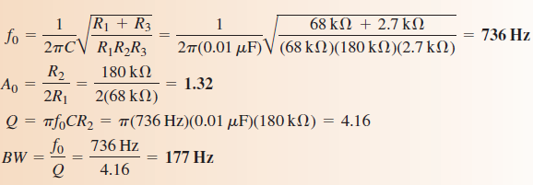
Multiple-Feedback Band-Pass Filter

Slide 32
State-Variable Filter
widely used for band-pass applications.
it consists of a summing amplifier and two op-amp integrators (which act as single-pole low-pass filters) that are combined in a cascaded arrangement to form a second-order filter.
Although used primarily as a band-pass (BP) filter, the state variable configuration also provides low-pass (LP) and high-pass (HP) outputs.
The center frequency is set by the RC circuits in both integrators.

Slide 33
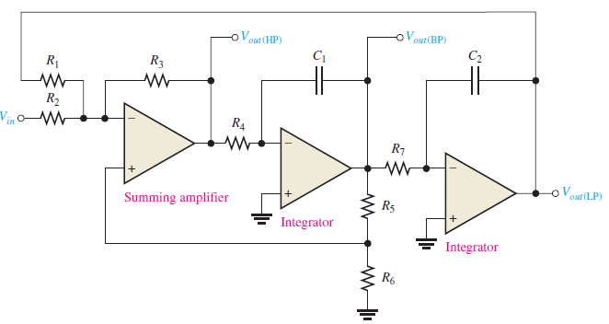
State-Variable Filter

Slide 34
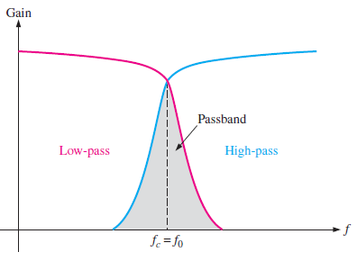

State-Variable Filter

Slide 35
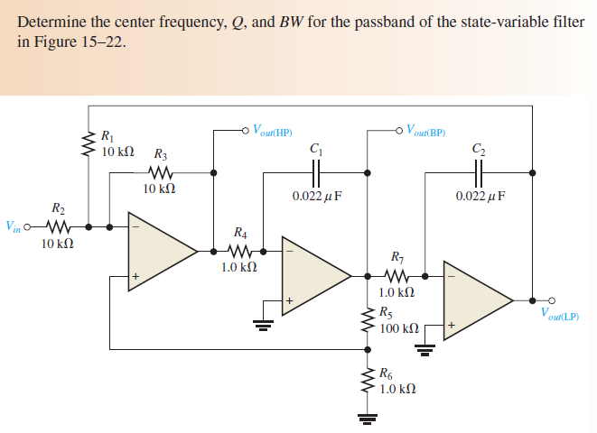
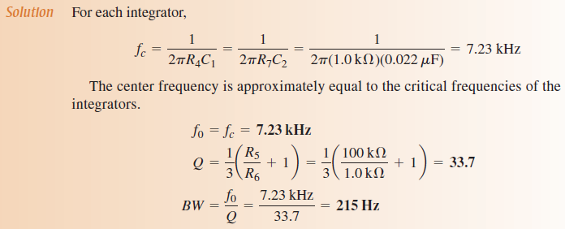
State-Variable Filter

Slide 36
The Biquad Filter
The biquad filter is similar to the state-variable filter except that it consists of an integrator, followed by an inverting amplifier, and then another integrator.
These differences in the configuration between a biquad and a state-variable filter result in some operational differences although both allow a very high Q value.
In a biquad filter, the bandwidth is independent and the Q is dependent on the critical frequency; however, in the state-variable filter it is just the opposite: the bandwidth is dependent and the Q is independent on the critical frequency.
Also, the biquad filter provides only band-pass and low-pass outputs.

Slide 37
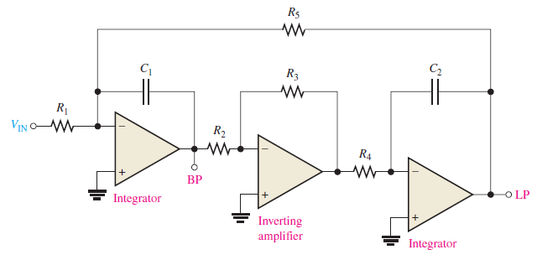
The Biquad Filter

Slide 38
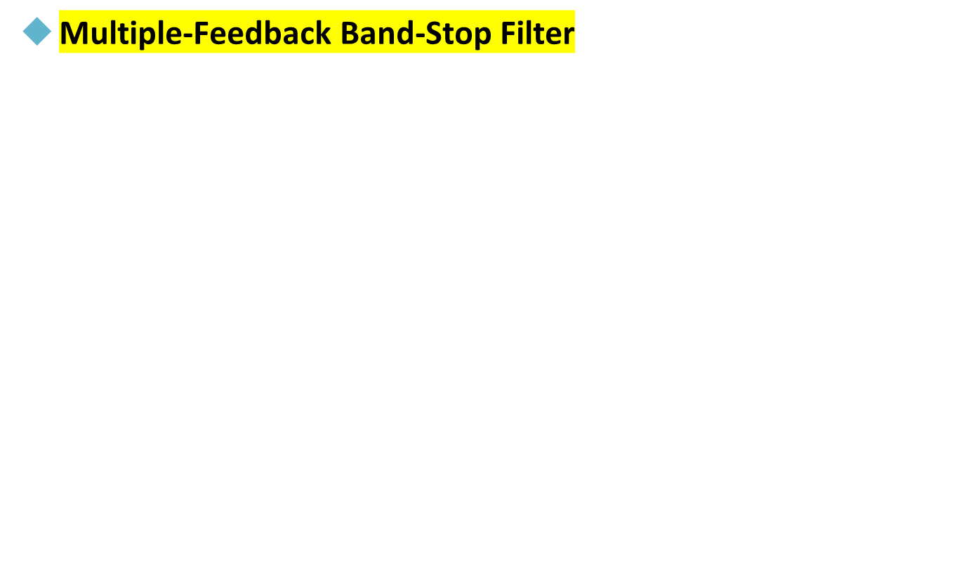
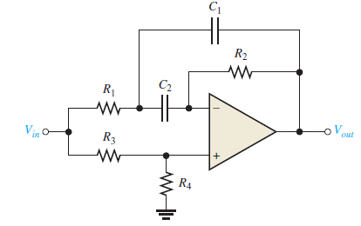
Band stop Filter

Slide 39
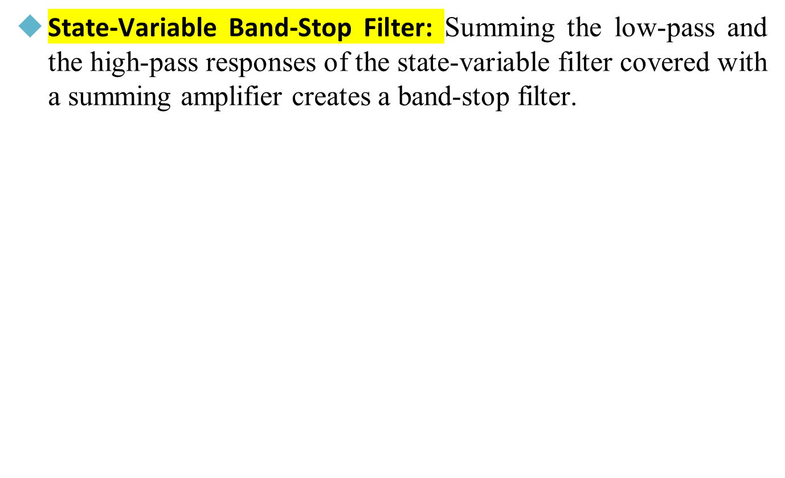
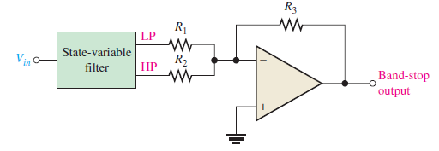
Band stop Filter

Slide 40
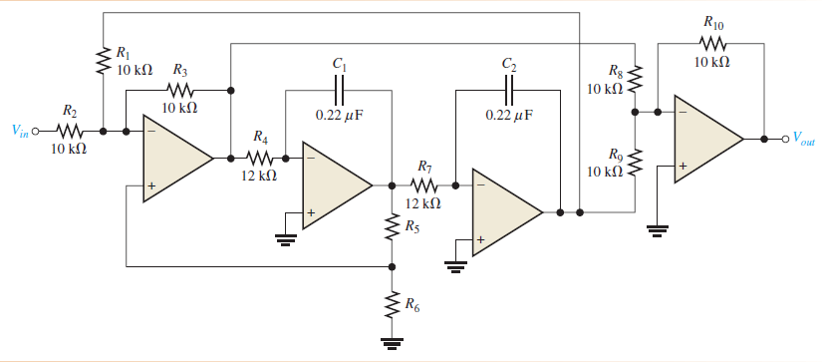
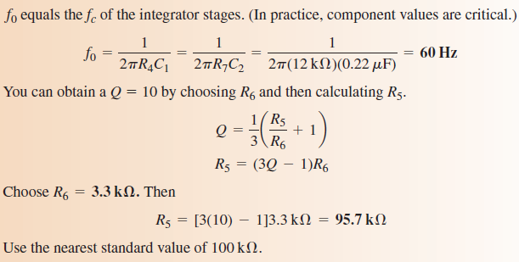
Band stop Filter

